Slide 1
Business Card Manager
邓炯尧 20151684

Slide 2
Application background
Business cards play an important role in business cooperation and social communication. People exchanging business cards to express friendship and exchange communication methods. With constant communication, people hold more and more business cards. How to manage a large number of business cards becomes a problem. This “Business Card Manager" application is an application that can help people manage their business cards better and easier.

Slide 3
Activity of the Application
There 5 activity in this application:
1.Recently Activity
2.Index Activity
3.Manage Activity
4.Search Activity
5.Detail Activity

Slide 4
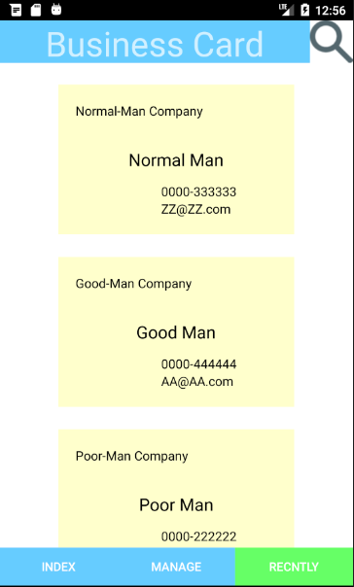
Recently Activity
In this activity, business cards are displayed in a list, sorted by the most recent visit time. You can click on a single card to enter the card's detail activity. You can also click on the icon in the upper right corner to enter the search activity. You can also click the other two buttons at the bottom of the screen to enter the index activity and manage activity.

Slide 5
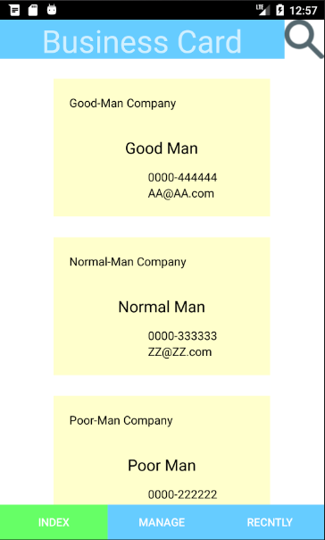
Index Activity
The index activity is very similar with the recently activity. Except of the business cards sort, the others are basically the same. In the index activity, business cards are sorted by people’s name.

Slide 6
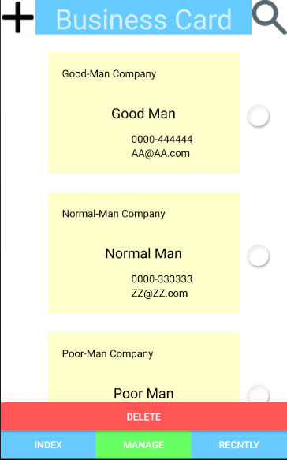
Manage Activity
In this activity, business cards are sorted by people’s name. You can click on the icon in the upper left corner to create a new business card. You can also click on the icon in the upper right corner to enter the search interface. You can click on the business card in the list to select them. When you click on the "Delete" button below, the business cards you selected will be deleted.

Slide 7
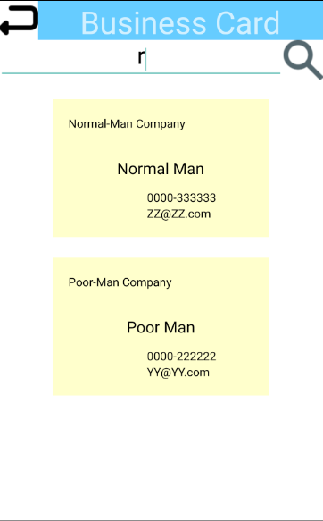
Search Activity
In this activity, you can click the icon in the upper left corner to exit the search activity and return to the previous activity. You can search for your desired business card by entering keywords in the search box. When the search results appear, you can click on them and enter their detail activity.

Slide 8
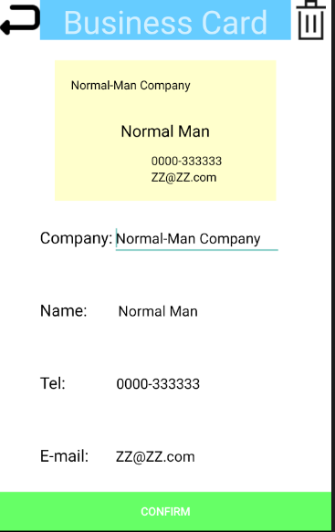
Detail Activity
In this activity, you can click the icon in the upper left corner to exit the detail activity and return to the previous activity. You can also click the icon in the upper right corner to delete this business card. When you are creating a new business card, various items on this activity are empty. You need to fill them and click on the “Confirm" button below to finish creating. When you click on an existing business card and enter this activity, you can change the content and click on the “Confirm" button below to update it.

Slide 9
Video Demo

Slide 10
Thank You!

